Slide 1
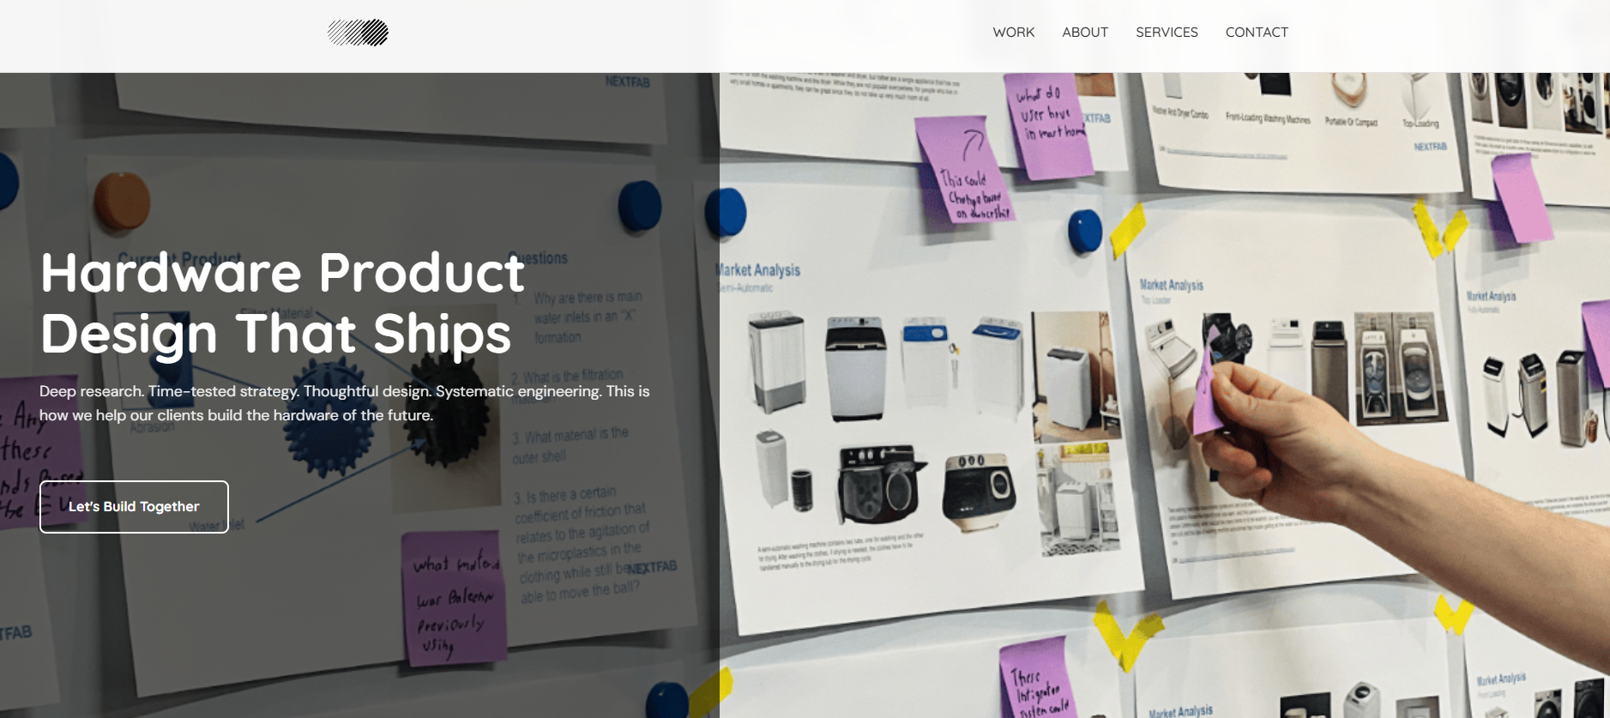
LABS
HARDWARE FROM CONCEPT TO
COMMERCIALIZATION
Deep Research • Time-Tested Strategy • Thoughtful Design • Systematic Engineering
Product design that ships, for companies building the future of hardware.

Slide 2
Flexible Expertise to Solve Your Hardware Challenges
Every company’s hardware challenges are unique, but the kind of expertise required to solve them is remarkably consistent: seasoned design and engineering talent that delivers high-quality results and spots and solves problems before they become costly delays.
Most companies face the same dilemma: they need this capability, but don’t have the time, budget, or headcount to build it internally. Hiring full-time specialists you might not need long-term isn’t the answer.
Partnering with flexible experts is. We provide that flexibility - ensuring you get the right expertise, at the right moment, without the overhead or long-term burden.

Slide 3





THE
DIFFERENCE
EVIDENCE-BASED DEVELOPMENT
SMALL, EXPERT TEAM
Our work is guided by data - from real-world testing and user feedback, not assumptions. We minimize risk by validating key design choices throughout the development process.
We’ve built a team of senior engineers and designers who have helped scores of clients succeed. Our low overhead, direct access approach lets you work directly with the talent you need to solve problems.
DEEP ENGAGEMENT
STARTUP DNA
We go deep with our projects, understanding before we execute. This ensures that our work is anchored on a foundation of truth and can stand up to heavy scrutiny and real-world testing.
Our fast, agile approach was honed through collaborations with 50+ startups. We’re about making maximum impact with minimal overhead and zero corporate bureaucracy.

Slide 4
End-to-End Hardware Product Development
From crafting a comprehensive development strategy to scaling to pilot production and beyond, we provide the complete range of expertise needed to transform your hardware concept into a successful commercial product.
Research & Strategy
Industrial Design
Mechanical Engineering
Electrical Engineering & Embedded Systems Design
Cards flip on click or hover
Prototyping & Testing
Manufacturing Preparation

Slide 5
End-to-End Hardware Product Development
From crafting a comprehensive development strategy to scaling to pilot production and beyond, we provide the complete range of expertise needed to transform your hardware concept into a successful commercial product.
Market & competition analysis
Risk identification & prioritization
Product roadmap development
Concept generation
Journey mapping & storyboarding
Form and CMF development
Hardware UI/UX design
Electromechanical system design
Computer Aided Design
Part fabrication & prototype assembly
Electrical system design & part selection
Breadboard prototyping
Firmware development
PCB design
Cards flip on click or hover
Sourcing & assembly of Alpha & Beta Prototypes
Test plan development
Prototype testing & analysis
Design for manufacturability & assembly
Supply chain development & management
Product certification facilitation

Slide 6















OUR CLIENTS
Trusted by innovative companies - from startups to established brands - we partner with clients across industries to de-risk and commercialize breakthrough hardware products.

Slide 7

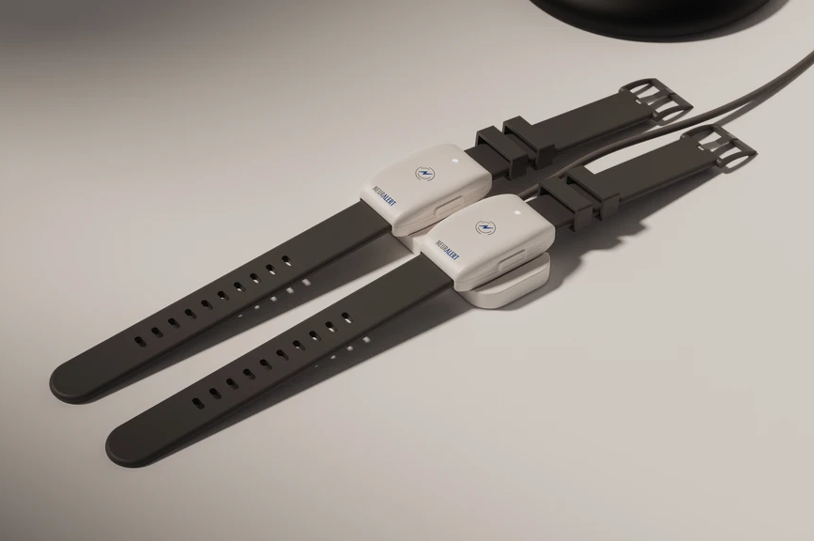
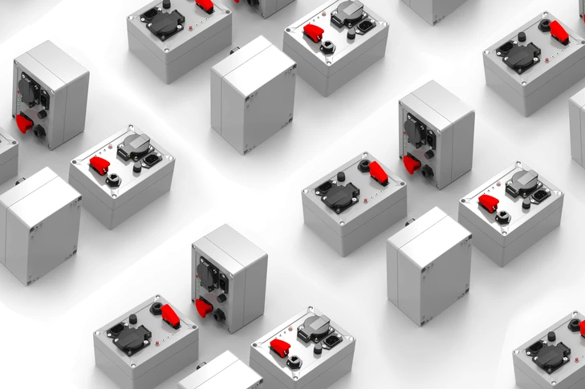
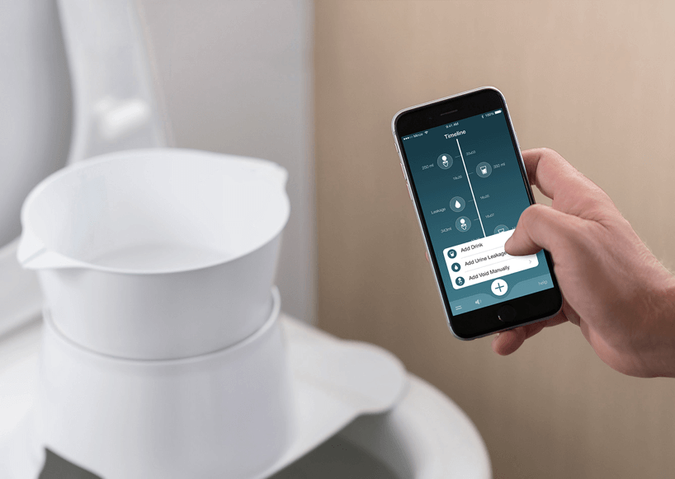
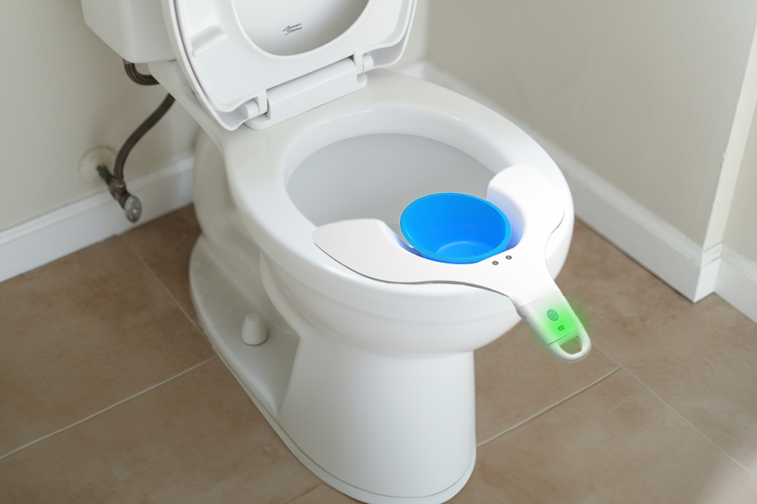
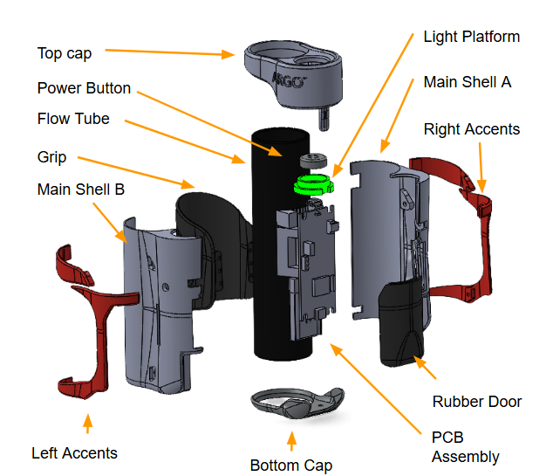
OUR WORK
UroGenie
mindvybe
Argospire

Slide 8
Hover over effect - text box with info on project pops up
OUR WORK
Animal Research Device
Client: Penn Vet
Services: electrical engineering // PCB design // firmware development // enclosure design // pilot production
Stroke Detection Wearable
Client: Neuralert
Services: electrical engineering // concept development // rendering
Hardened IoT Switch
Client: Hala Systems
Services: electrical engineering // PCB design // firmware development // enclosure design // supply chain development // production support
UroGenie
mindvybe
Argospire
Uroflow Device
Client: UroGenie
Services:
Vagus Nerve Stimulation Device
Client: Penn Vet
Services:
Connected Spirometer
Client: Argospire
Services:

Slide 9
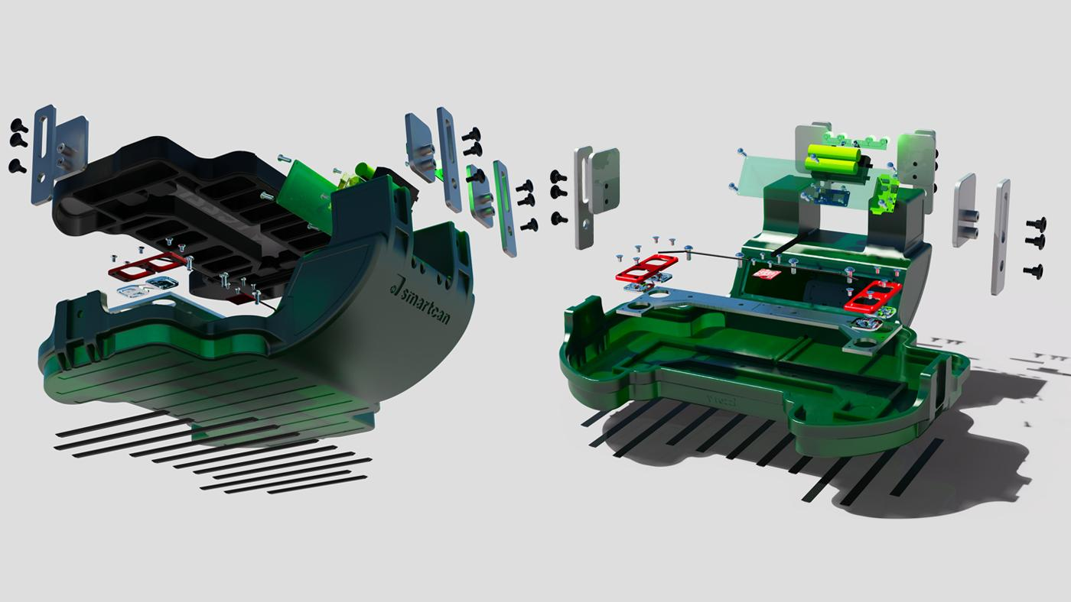
LET’S BUILD SOMETHING EXTRAORDINARY TOGETHER
Ready to ship your product?
Schedule a Call
Send a Message

Slide 10


CONTACT
Name
Message
Email
Company
2212 Walnut Street, 1st Floor
Philadelphia, PA 19103
hello@solidpd.com
Schedule a call
© 2025 Solid Product Design. All rights reserved.

Slide 11
Actions to take upon clicking links on the page
Header
Work -> slide 7
About -> slide 2
Services -> slide 4
Contact -> slide 10
Labs -> placeholder separate page [or omit if that’s better for now]
Slide 9
Schedule a call -> https://calendar.app.google/8KWMbY5n79jBBe4U9
Send a message -> slide 10
Slide 10
Schedule a call -> https://calendar.app.google/8KWMbY5n79jBBe4U9
LinkedIn icon -> linkedin.com/company/solidpd/

Slide 12
Scratch Pad

Slide 13









BACKUP LOGOS
Maybe
Penn Medicine?
CHOP?
Nemours Children's Health?
Cooper?
Comcast
Emerson

Slide 14
Emphasis on fundraising readiness
SBIR
Angel/VC

Slide 15


